Slide 1
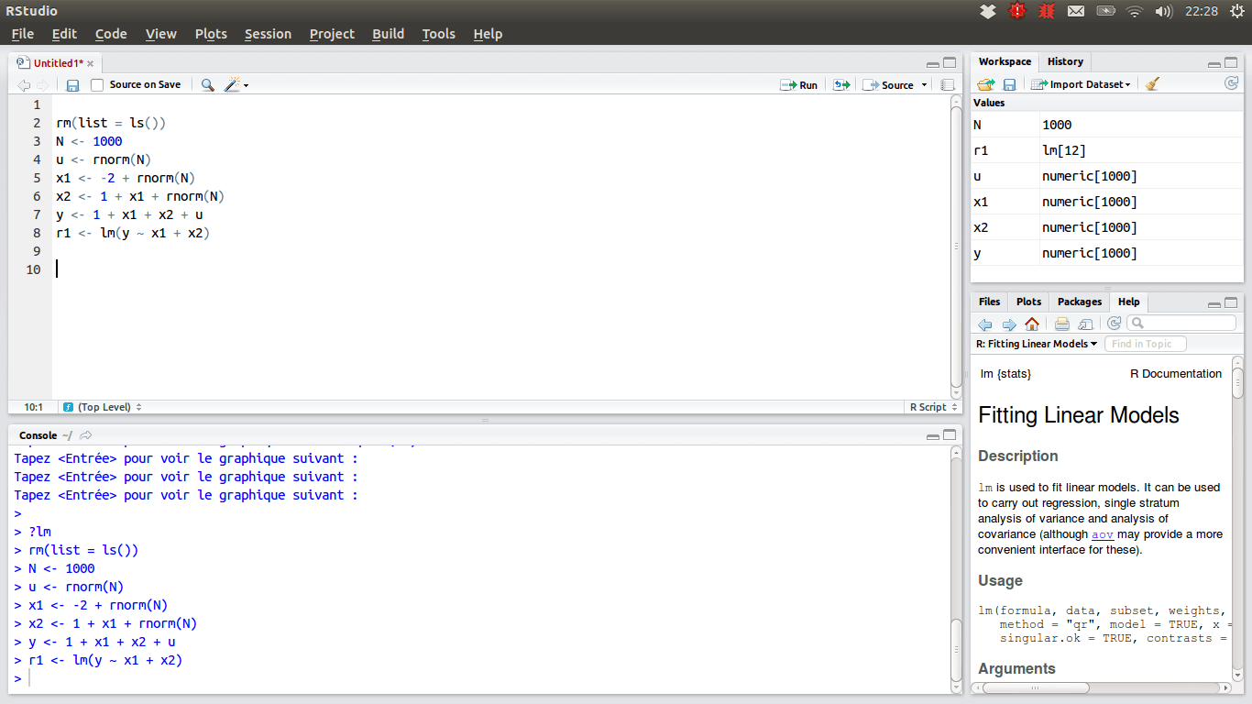
SUMMER INTERNSHIP REPORT
Traffic and Road Safety Analysis
(at Jasiel Creations)
By MUSKAN SINGHAL
RA1711008010070

Slide 2
Introduction of the research
In this thesis we present a comprehensive study into novel series models for aggregated road safety data. The models are mainly intended for analysis of indicators relevant to road safety, with a particular focus on how to measure these factors. Such developments may need to be related to or explained by external inﬂuences. It is also possible to make forecasts using the models. Relevant indicators include the number of persons killed per month or year. These statistics are closely watched by government agencies and the public, and their relevance to society is not disputed. A large body of research is devoted to the improvement of road safety. To that end, changes in the number of accidents or victims are often attempted to be explained by factors such as exposure, policy, driving under the inﬂuence of alcohol, speeding by drivers. Some factors such as policy changes can be directly observed.

Slide 3
JASIEL CREATIONS
Jasiel is a global Design and Technology firm specialized in emerging era of interactive communication with many successful executions. Strategic partnerships with Research & Development houses across the globe enriches us with current and future market trends in the field of technology. Possessing not only the power to innovate, but to customize the innovation leads us & our customers to endless opportunities with 100% customizable solutions. With a team of young engineers, entrepreneurs and elite intellectuals, Jasiel’s mission is to revive the industry with continuous novel experience.
Jasiel creations aim not only at possessing the power to innovate but also to customize the innovation not only in India, Dubai, Australia but in the entire world.

Slide 4
WORKING ON R AND Rstudio
R is the name of the programming language used itself and RStudio is a convenient interface. People all over the world are turning to R, an open source statistical language, to make sense of data. Inspired by the innovations of R users in science, education, and industry, RStudio develops free and open tools for R and enterprise ready professional products for teams to scale and share work.
The panel in the upper right contains your workspace as well as a history of the commands that you’ve previously entered.
Any plots that you generate will show up in the panel in the lower right corner. The panel on the left is where the action happens. It’s called the console. Everytime you launch RStudio, it will have the same text at the top of the console telling you the version of R that you’re running.
Below that information is the prompt. As its name suggests, this prompt is really a request, a request for a command.
Initially, interacting with R is all about typing commands and interpreting the output. These commands and their syntax have evolved over decades (literally) and now provide what many use.

Slide 5
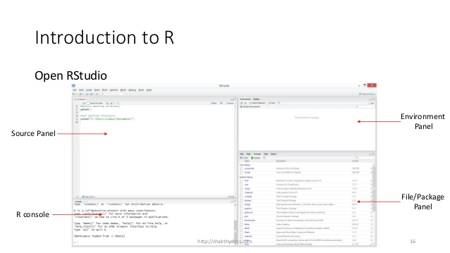
Rstudio is encouraged to be used as it :
Provides community support.
Enforces best practices like documentation, version control, unit testing.
Integrates R packages, documentation, debugging and viewing tools.

Slide 6
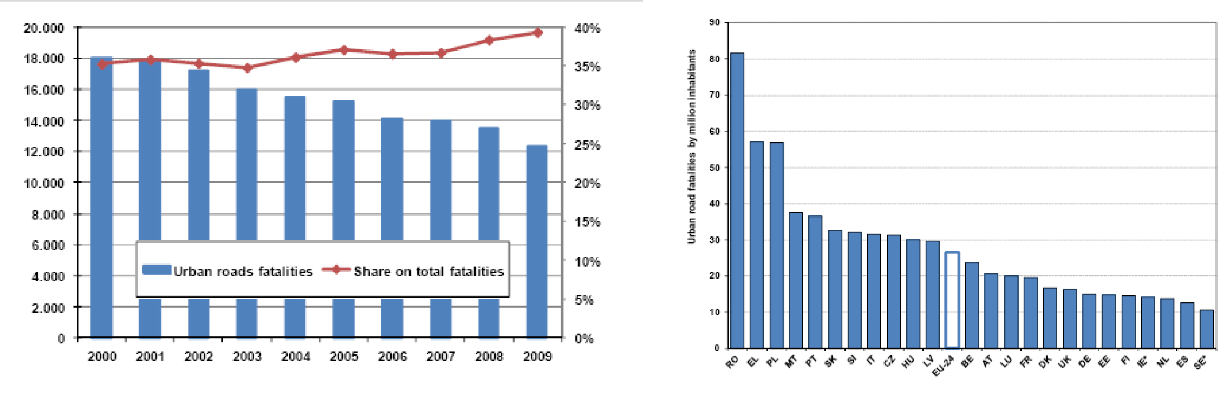
Different road safety progress in different countries
Road Fatalities change 2001-2010 (source: CARE)
Urban Areas
Inside Outside
North western countries
Southern countries
Eastern Countries
-48,4% | -50,0%
-47,7% | -42,4%
-22,6% | -24,3%

Slide 7
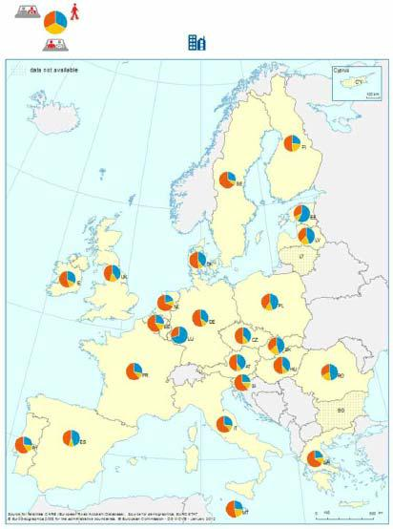
Different road safety problems in different countries
Road Fatalities 2010 (source: CARE)
Power Two Wheelers
Urban | Total | %
848 | 3.776 | 22%
1.091 | 3.399 | 32%
434 | 4.183 | 10%
North-Western countries
Southern countries
Eastern countries
Cyclists
Inside | Total | %
472 | 3.776 | 13%
203 | 3.399 | 6%
400 | 4.183 | 10%
North-Western countries
Southern countries
Eastern countries
Pedestrians
Urban | Total | %
1.249 | 3.776 | 33%
1.066 | 3.399 | 31%
1.888 | 4.183 | 45%
North-Western countries
Southern countries
Eastern countries

Slide 8
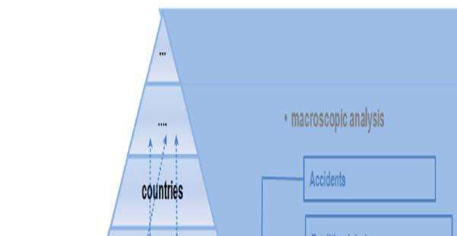
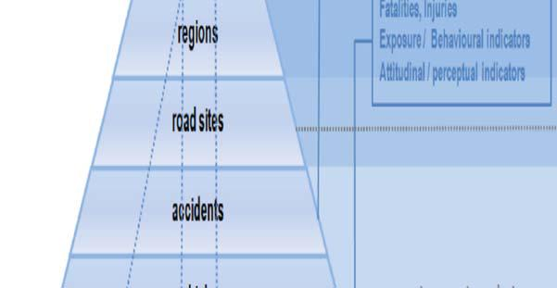
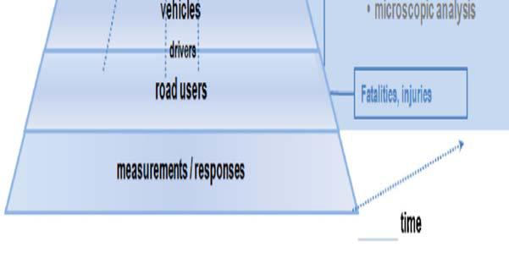
The use of rigorous analysis techniques
MULTILEVEL ANALYSIS
Hierarchical structures in road safety data receiving increasing attention in literature. This higher level model has parameters ( mean, variance) of its own. They aim to capture dependencies among observations due to their hierarchical structure.
Basic Multilevel model formulation:
Observations i are nested within units j
yij = β0j + β1J.xij + εij
β0j | = | β0 | + u0j | u0j ~ N [0, σ²0j]
β1j | = | β1 | + u1j | u1j ~ N [0, σ²1j]

Slide 9
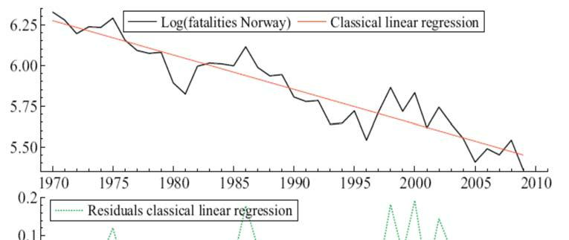
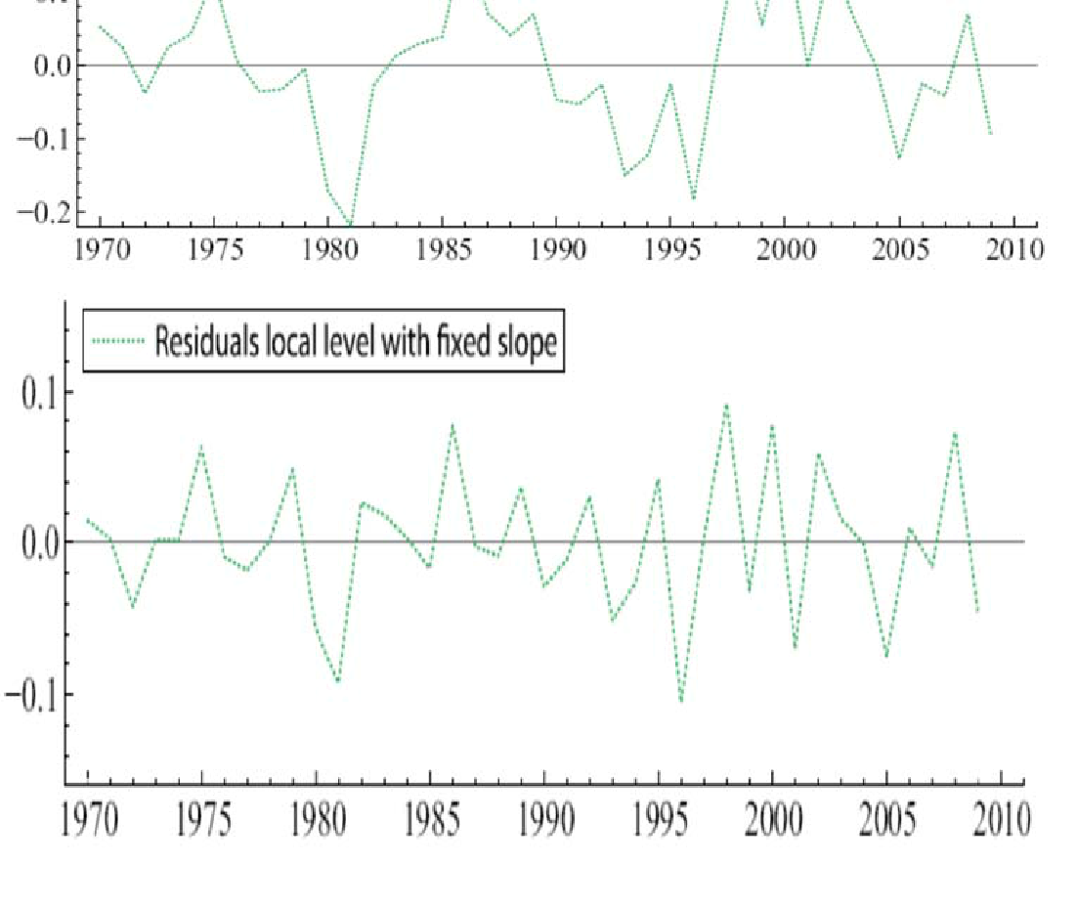
2. TIME SERIES ANALYSIS
Road safety observations are often serially correlated (time series) – autocorrelation.
Although linear and GLM models may, under certain conditions, be used for time series analysis, only dedicated techniques may fully account for this type of dependencies that are
- ARIMA models
- State-space models
Time series analysis components are
Trend
Seasonality

Slide 10
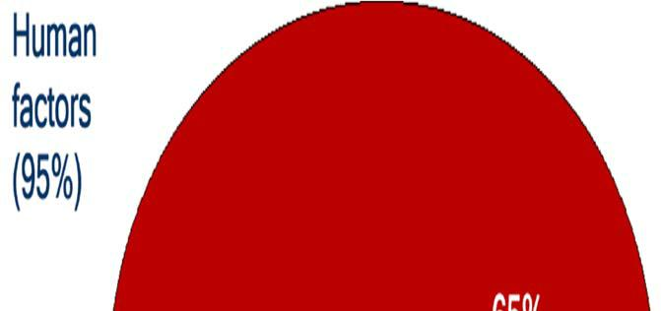
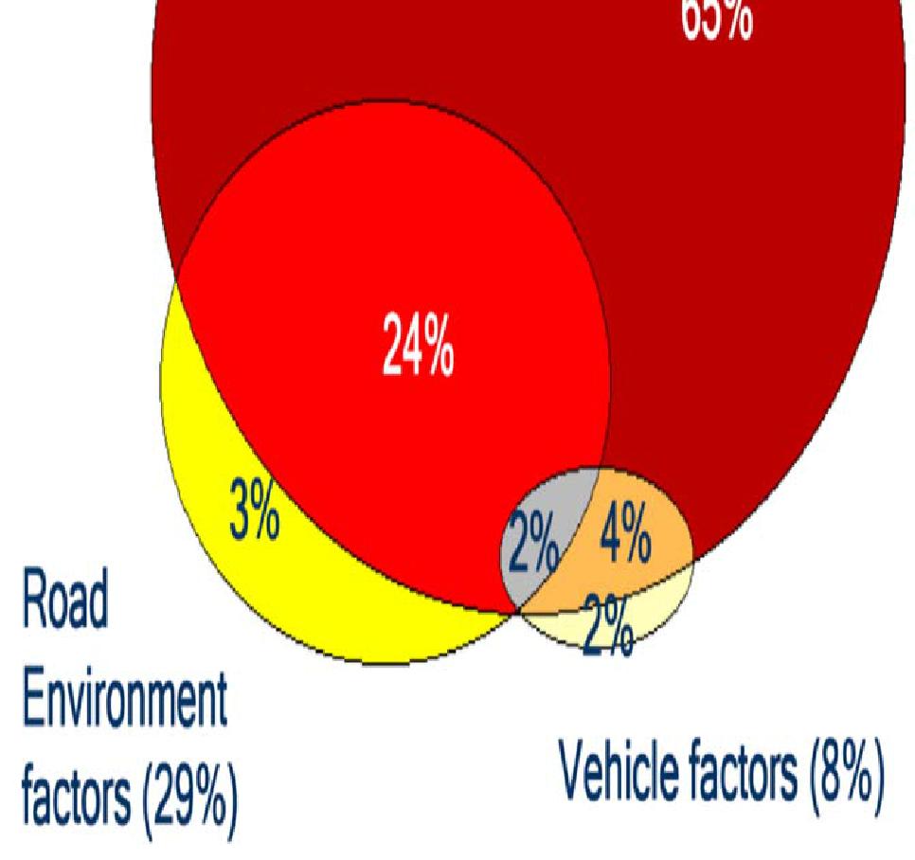
Understanding road user behaviour
Human factors are the basic causes of road accident in 65-95% of road accidents.
Human factors include a large number of specific factors that may be considered as accident causes, including:
- driver injudicious action (speeding, traffic violations etc.)
- driver error or reaction (loss of control, failure to keep safe distances, sudden braking etc.)
- behaviour or inexperience (aggressive driving, nervousness, uncertainty etc.)
- driver distraction or impairment (alcohol, fatigue, mobile phone use etc.).

Slide 11
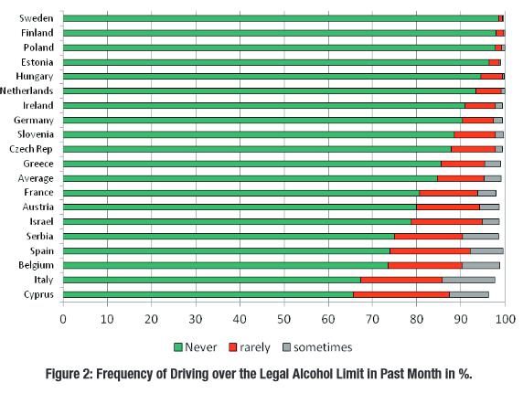
Monitoring road safety attitudes and perceptions
- SARTRE surveys (Social Attitudes to Road Traffic Risk in Europe), 1993, 1996, 2003, 2012
- A common questionnaire on national random samples of 1000 participants
- Mobility and travel motivations
- Risk perception
- Attitudes towards measures
- Driver self-assessment
- Self-reported behaviour like speeding, alcohol etc.

Slide 12
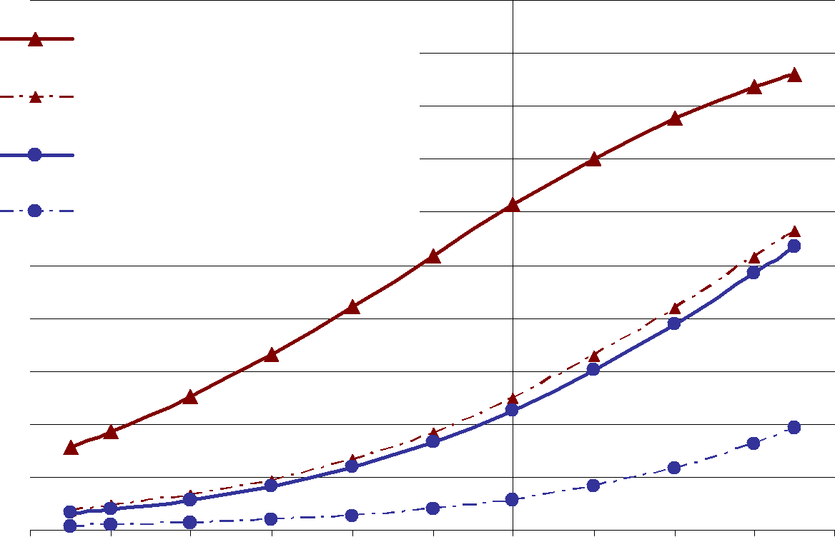
Mobile phone use, driver speed and accident probability
Participants: 48 drivers aged between 19 and 27 years, out of which 29 were males and 19 were females.
The experiment included 3 simulated drives in a rural road environment during good weather conditions.
- Simple mobile phone conversation: basic questions on driver’s characteristics (age, name, job, hobbies, news etc.
- Complex mobile phone conversation: questions requiring some concentration, as well as some logical and mathematical reasoning.
Accident probability due to phone use and weather conditions in case of an incident
accident probability
Talking on the phone - rainy
Not talking on the phone - rainy
Talking on the phone - good weather
Not talking on the phone - good weather
-60 | -50 | -40 | -30 | -20 | -10 | 0 | 10 | 20 | 30 | 40
% change in speed while using mobile phone

Slide 13
- Listening to music.
- Simple and complex mobile phone conversations were associated with reduced speeds.
- Listening to music was associated with increased speeds.
- Only complex mobile phone conversation was associated with reduced reaction times and increased accident risk at unexpected incidents.

Slide 14
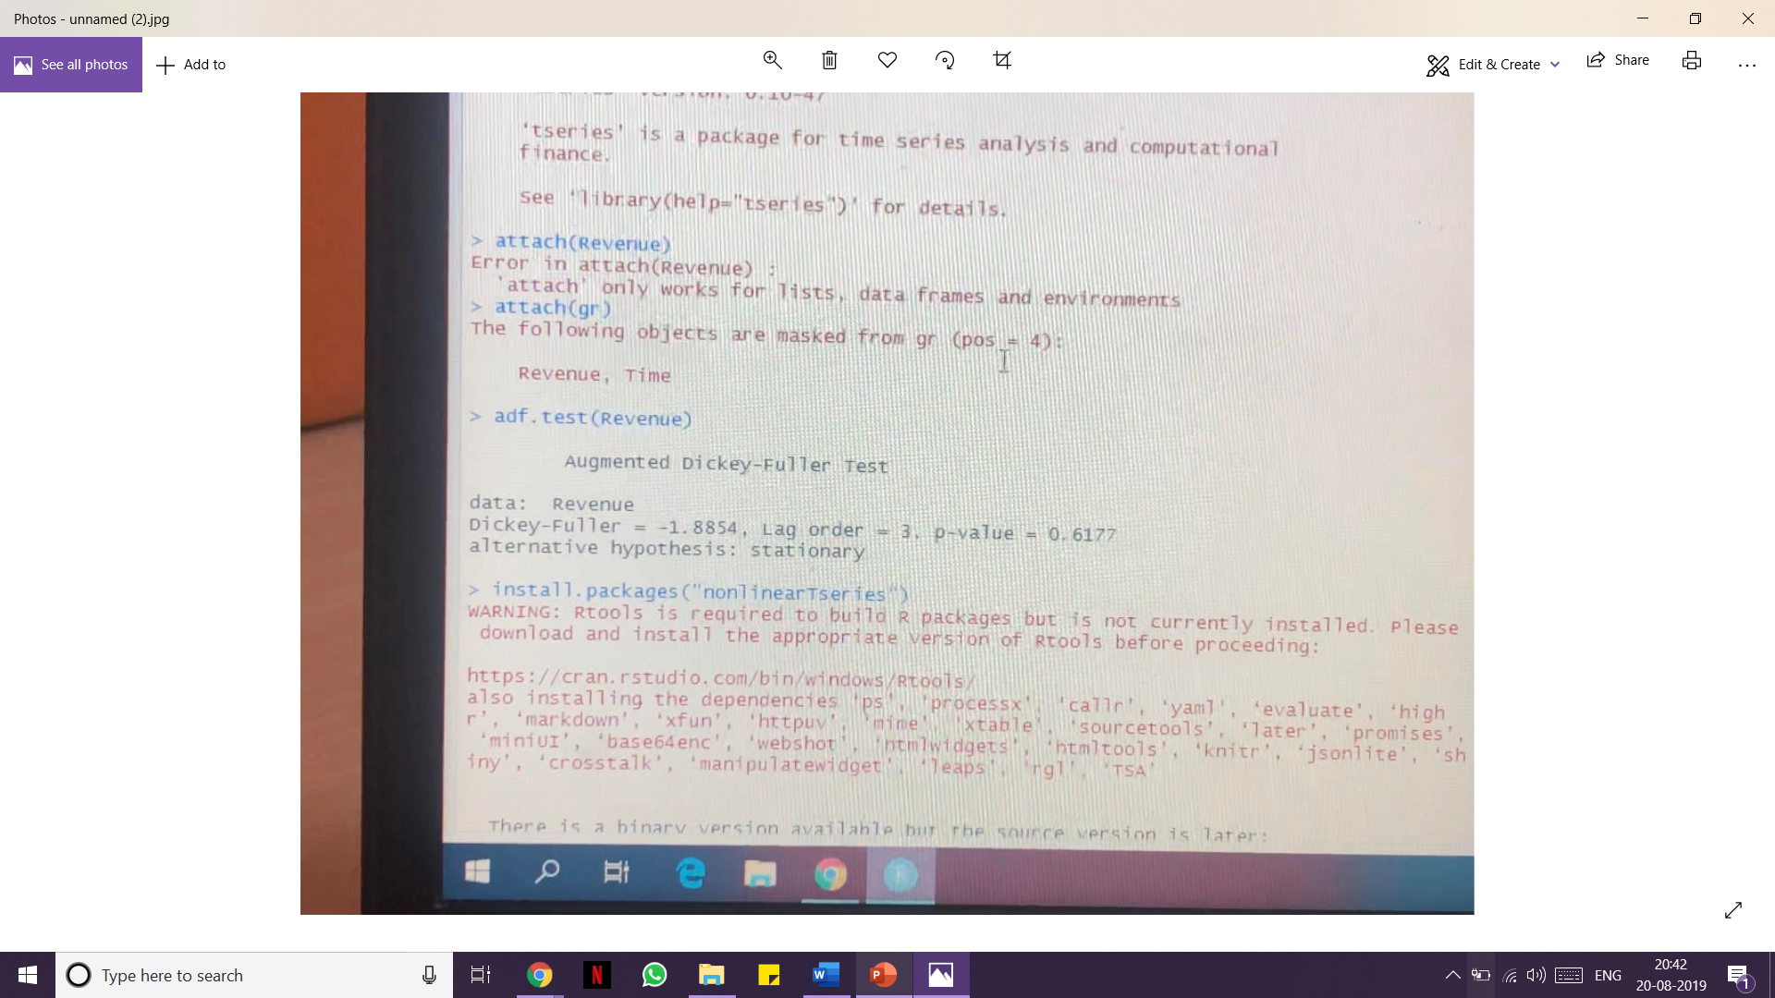
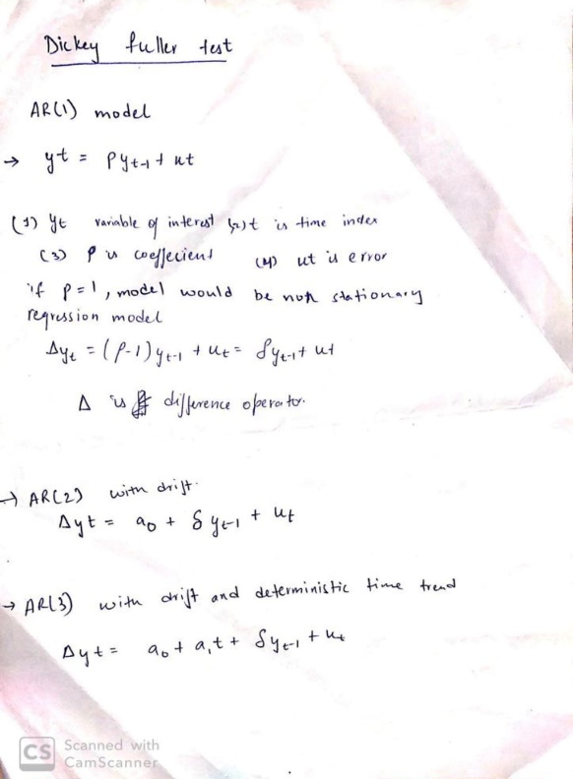
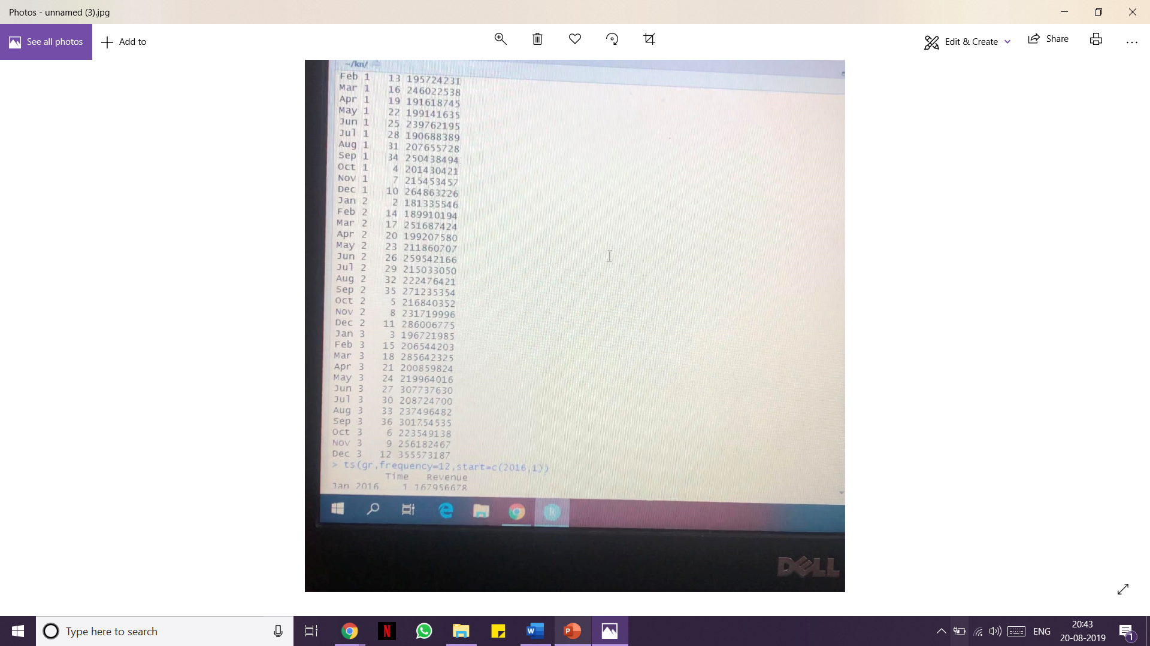
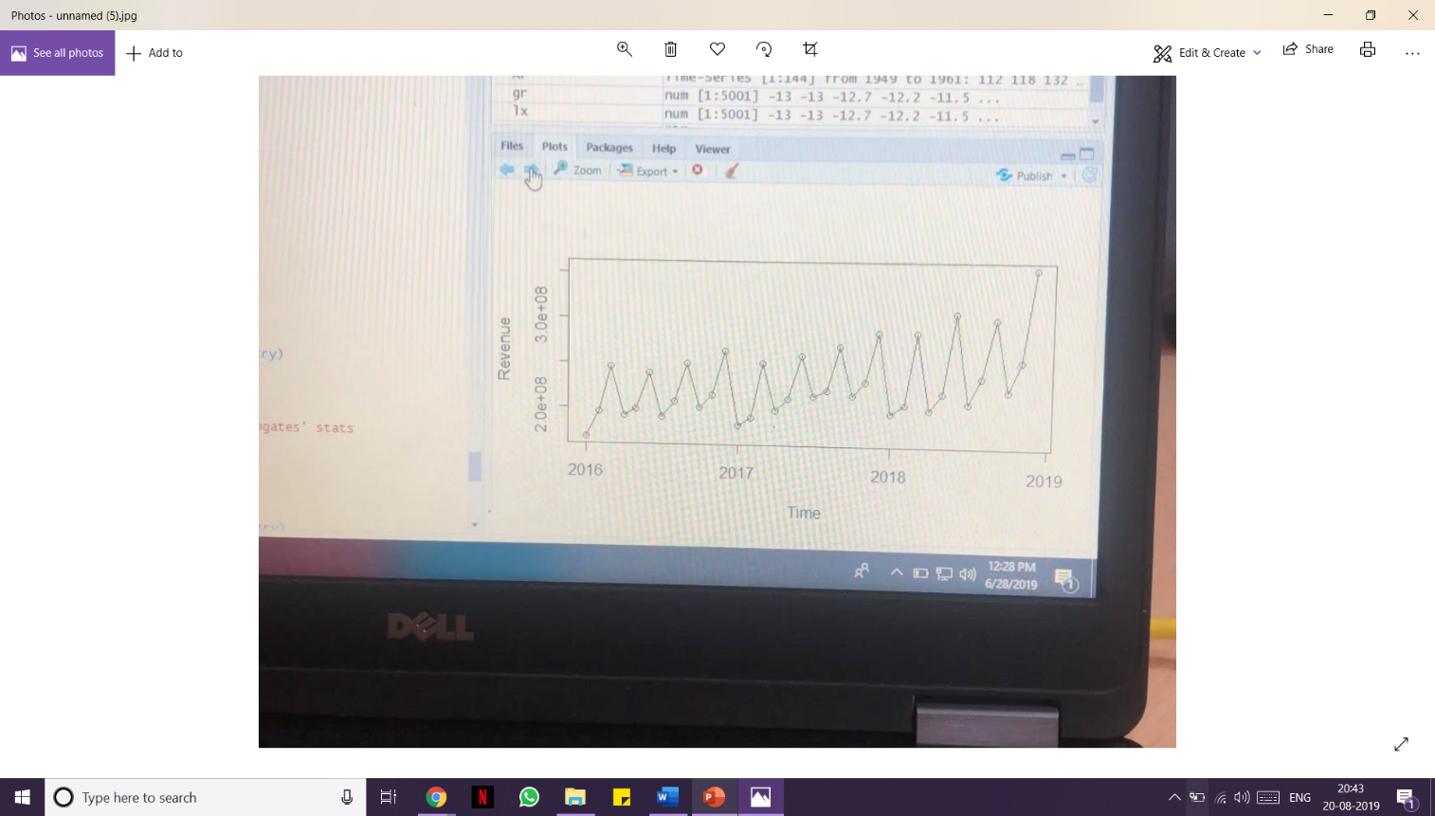
AUGMENTED DICKEY FULLER TEST
In statistics, the Dickey–Fuller test tests the null hypothesis that a unit root is present in an autoregressive model. The alternate hypothesis is different depending on which version of the test is used, but is usually stationarity or trend-stationarity.
It is named after the statisticians David Dickey
and Wayne Fuller, who developed the test in 1979.

Slide 15
About my research
During my internship research at Jasiel, we performed multiple tests for series analysis in order to observe different analytics on different sets of data.
One such test has been Augmented Dickey Fuller Test(ADF Test).
In statistics and econometrics, an augmented Dickey–Fuller test (ADF) tests the null hypothesis that a unit root is present in a time series sample. The alternative hypothesis is different depending on which version of the test is used, but is usually stationarity or trend-stationarity.
It is an augmented version of the Dickey–Fuller test for a larger and more complicated set of time series models.
The augmented Dickey–Fuller (ADF) statistic, used in the test, is a negative number. The more negative it is, the stronger the rejection of the hypothesis that there is a unit root at some level of confidence.

Slide 16

Conclusions and findings
I went through different research papers from different universities across the world , got to learn about different terms and definitions related to the topic of Series Analysis in Data Science using different types of software like R, Hadoop etc. In the end I was able to properly understand how to deal with any series related plot and how to handle the data and how to distinguish between Linear and Non-Linear Data , Stationary and Non-Stationary Data.
Also understood where I can implement this in real life scenarios.
Also with Data Science and Big data as my elective this semester , I surely would be able to ace it , as I learned a lot about the subject this summer.

Slide 17
THANK YOU
MUSKAN SINGHAL
RA1711008010070
INFORMATION TECHONOLOGY

